Slide 1

Categorical – Numerical Variables

Slide 2

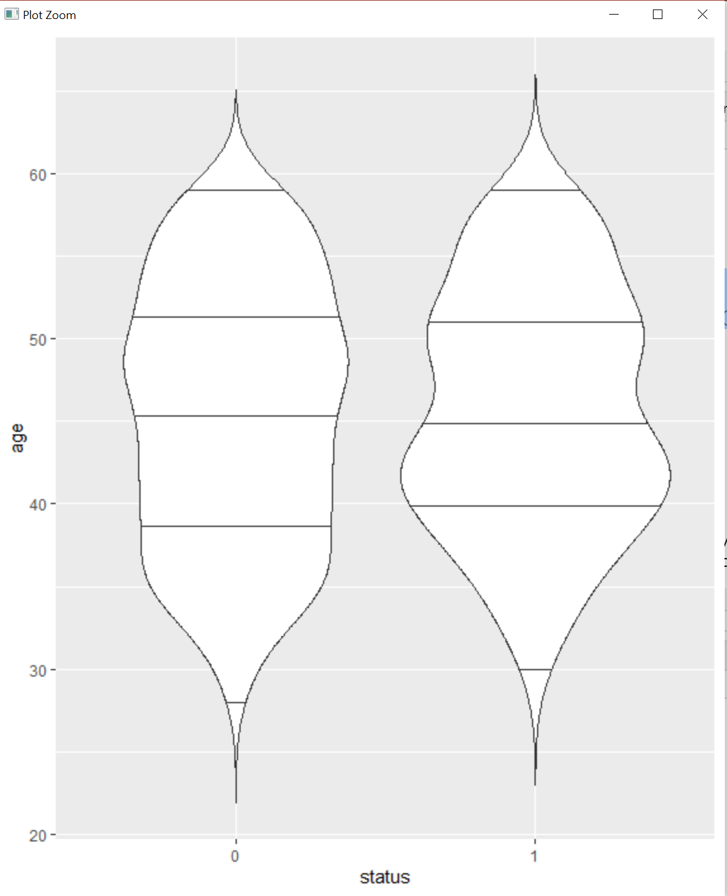
Age v/s Status
p <- ggplot(data, aes(x=status,y=age)) + geom_violin()
p + geom_violin(trim = FALSE) + geom_violin(draw_quantiles = c(0.25,0.5,0.75))
The violin plots can be comopared with the mean, median and mode value for age v/s status

Slide 3
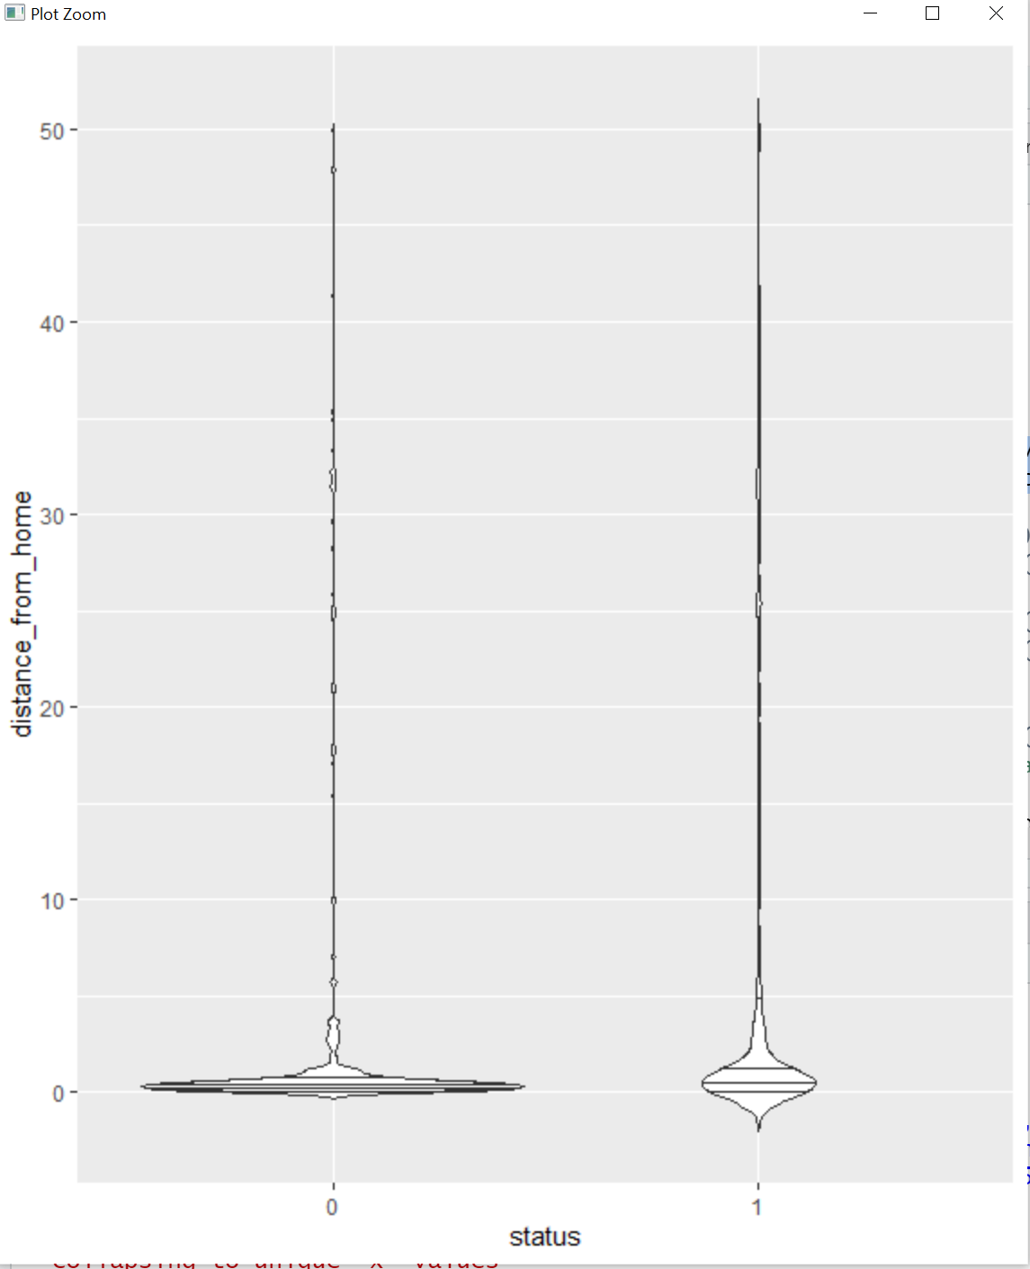
Distance from home v/s Status
p2 <- ggplot(data, aes(x=status,y=distance_from_home)) + geom_violin()
p2 + geom_violin(trim = FALSE) + geom_violin(draw_quantiles = c(0.25,0.5,0.75))
The violin plots can be compared with the mean, median and mode value for distance from home of employees v/s status

Slide 4
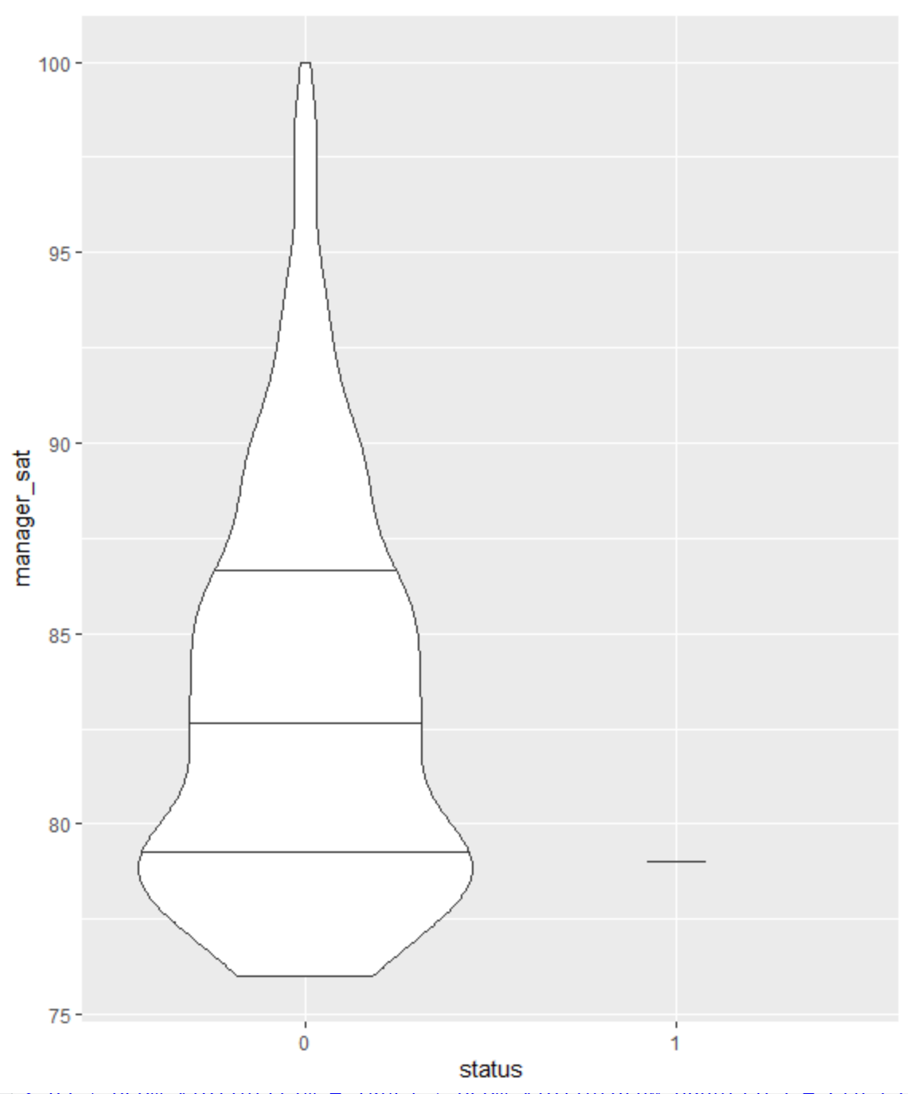
Manager_sat (manager satisfaction) v/s Status
p3 <- ggplot(data, aes(x=status,y=manager_sat)) + geom_violin()
p3 + geom_violin(trim = TRUE) + geom_violin(draw_quantiles = c(0.25,0.5,0.75))
The violin plots can be compared with the mean, median and mode value for manager satisfaction v/s status

Slide 5
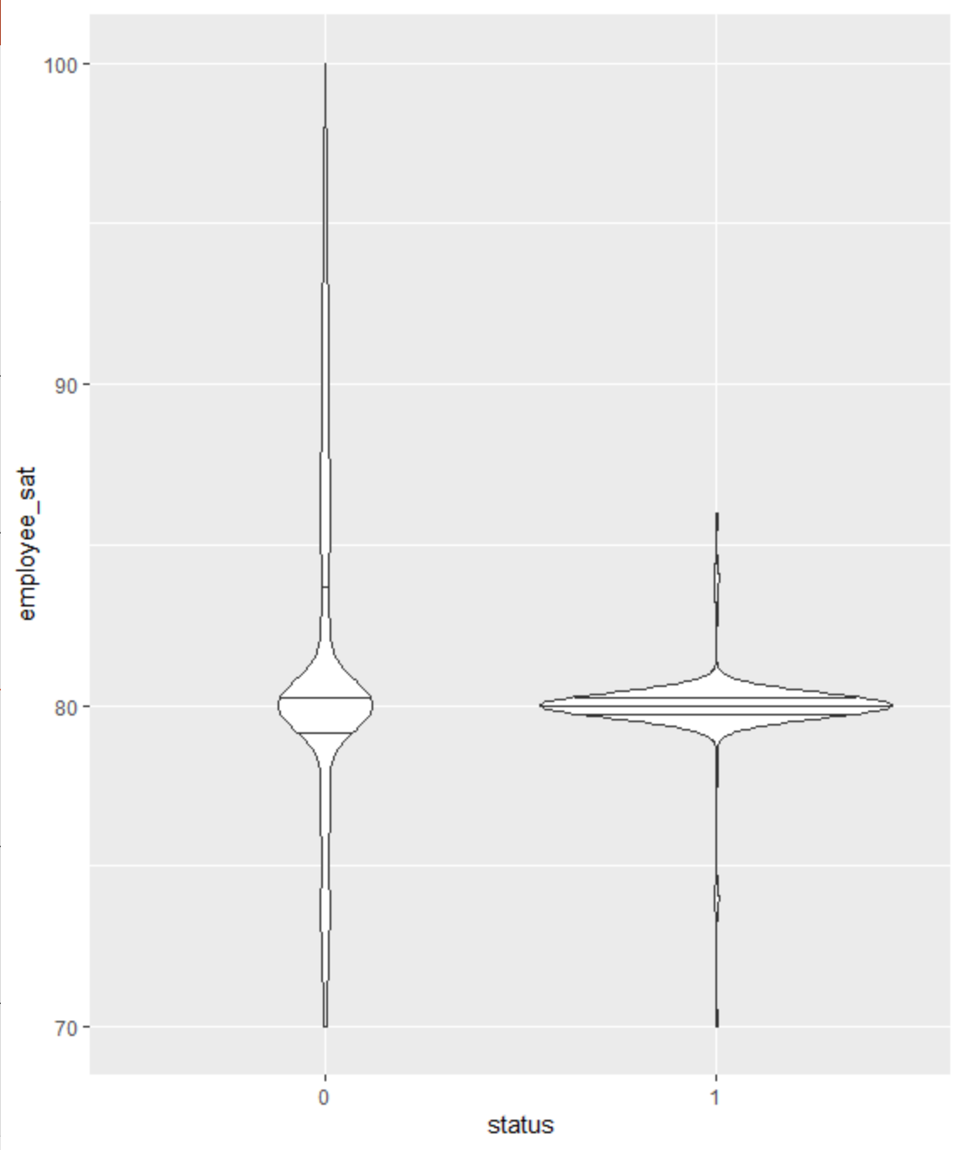
employee_sat (employee satisfaction) v/s Status
p4 <- ggplot(data, aes(x=status,y=employee_sat)) + geom_violin()
p4 + geom_violin(trim = TRUE) + geom_violin(draw_quantiles = c(0.25,0.5,0.75))
Quite interesting to see the skewness in the plots. For the one who underwent attrition, its more skewed on the right whereas the ones who did not undergo attrition, skewness was on the left hand side.
The violin plots can be compared with the mean, median and mode value for employee satisfaction v/s status

Slide 6
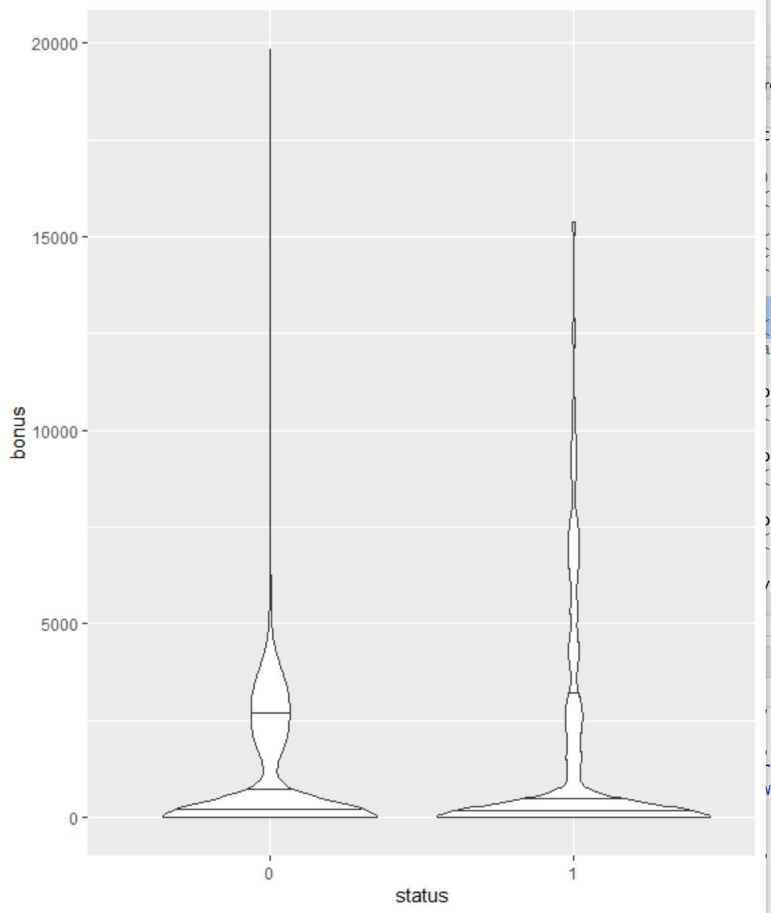
Bonus v/s Status
p5 <- ggplot(data, aes(x=status,y=bonus)) + geom_violin()
p5 + geom_violin(trim = TRUE) + geom_violin(draw_quantiles = c(0.25,0.5,0.75))
The violin plots can be compared with the mean, median and mode value for bonus v/s status

Slide 7
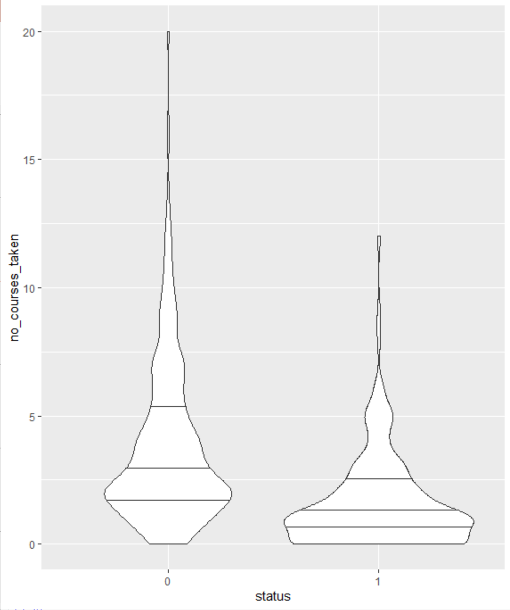
No of courses taken v/s Status
p6 <- ggplot(data, aes(x=status,y=no_courses_taken)) + geom_violin()
p6 + geom_violin(trim = TRUE) + geom_violin(draw_quantiles = c(0.25,0.5,0.75))
From the avg, max, min and median, we could conclude that may be the people are not happy with the courses and hence are leaving the company or could be managed horizontally than vertically or vice-versa

Slide 8
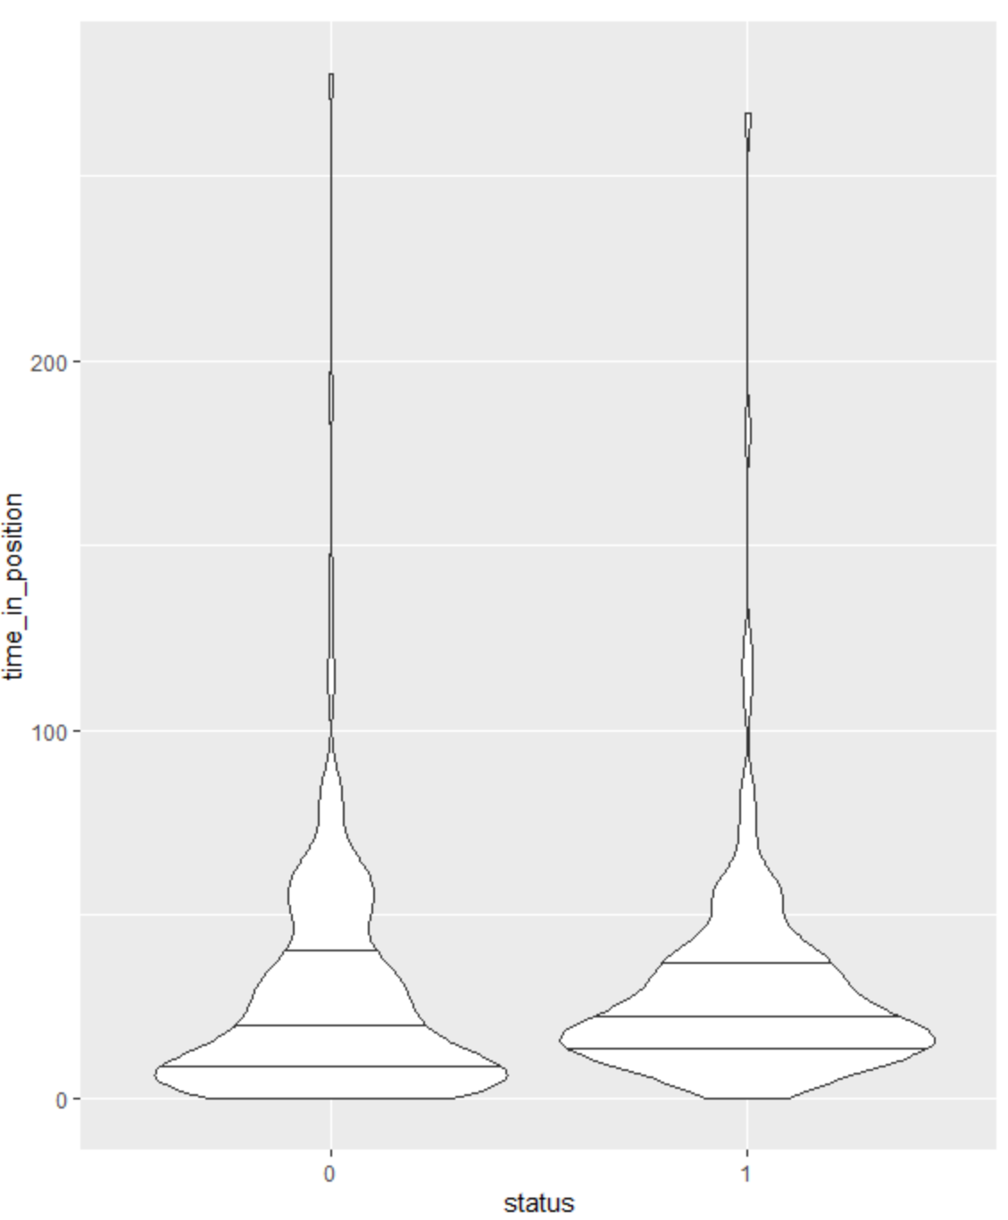
Time in position v/s Status
p7 <- ggplot(data, aes(x=status,y=time_in_position)) + geom_violin()
p7 + geom_violin(trim = TRUE) + geom_violin(draw_quantiles = c(0.25,0.5,0.75)) # maximum value - very very high, so there might be the case that something wrong with the data (outlier might be present)

Slide 9
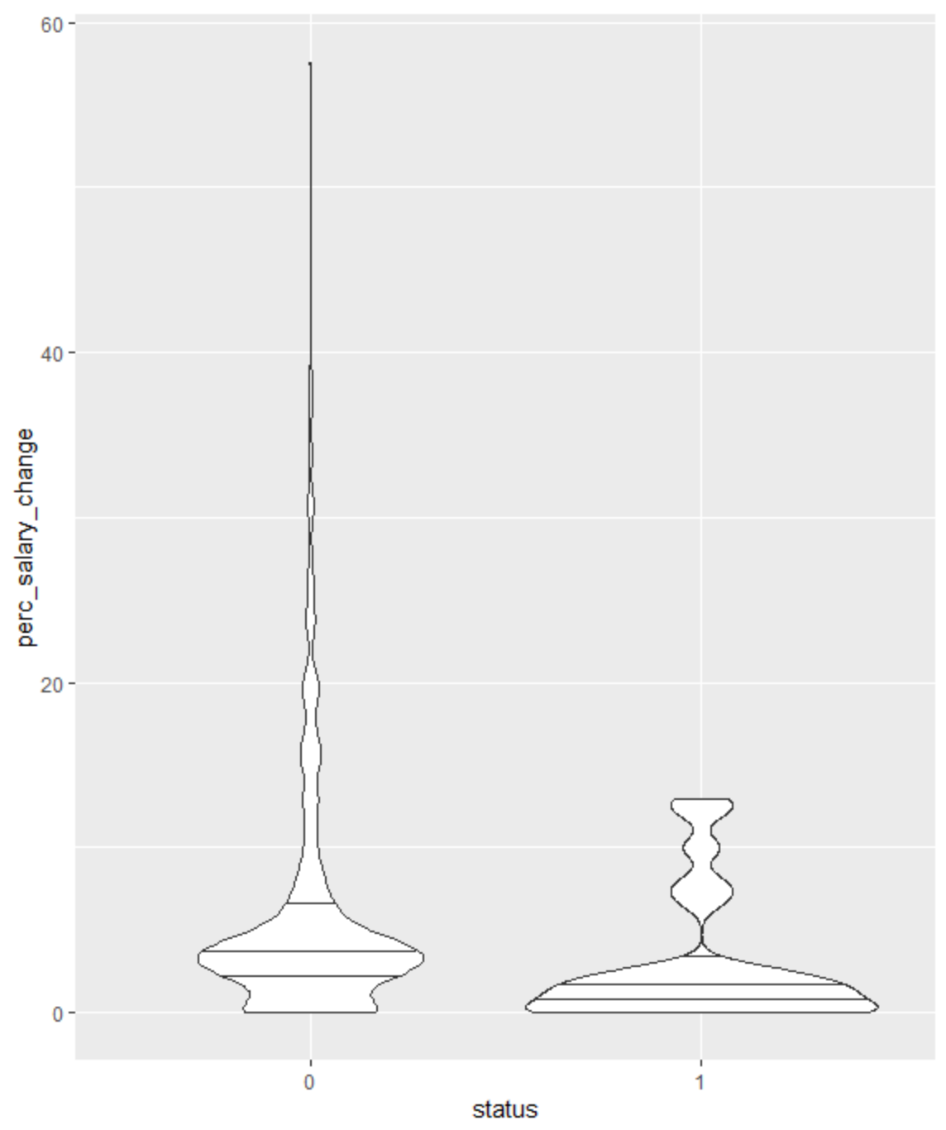
Percentage salary change v/s Status
p8 <- ggplot(data, aes(x=status,y=perc_salary_change)) + geom_violin()
p8 + geom_violin(trim = TRUE) + geom_violin(draw_quantiles = c(0.25,0.5,0.75)) # maximum salary change is the key.. if you do not give a good hike to the employee, they are bound to leave the company.

